Slide 1
ALMSHOUSE CONSORTIUM LIMITED
Registered Office: Station House, North Street, Havant, Hampshire PO9 1QU
Registered as a company limited by guarantee at Companies House Co Number 7749739
Contacts:
Programme Managers – Kathy Green kathy.green.projects@gmail.com Tel -01225 865573 and
Sean Stafford
Saffer Cooper | Office 206 | Ashton Old Baths | Stamford Street West | Ashton Under Lyne | OL6 7FW
Telephone: 0161 804 2222
Mobile: 07714 255520
@SafferCooperLtd www.SafferCooper.com
Sue Holden Administrator – acltabitha@gmail.com
Getting your project going

Slide 2
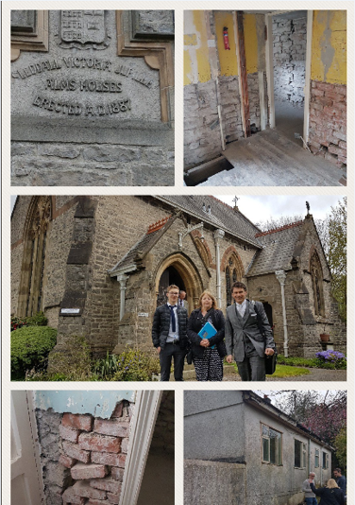
What is ACL?
Almshouse Consortium Limited is a non profit making Company Limited by Guarantee which is
  A route to obtaining grant funding from Homes England and the Greater London Authority
  Owned by almshouses having an allocation
  of grant funding
  A network of almshouses of varying sizes, giving access to the experience of others doing similar projects

Slide 3
Why join ACL?
HE and the GLA rarely give funding direct. They expect organisations to band together to form consortia. ACL is one such consortium which has already qualified with both grant funders as a Lead Partner.
Key expertise needed to access grant funding is available within ACL and can be accessed by Members.
You can undertake your project in company of others who understand what you are facing and can point you in the right direction. You are not alone.

Slide 4
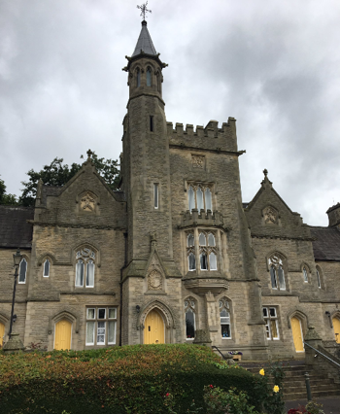
What does joining ACL mean?
Each almshouse nominates a Director who will represent the almshouse in decision making which affects the whole programme.
Meetings are held every 2 months in London
The costs of running the Company are shared, based on a percentage of grant received
Dealing with common items, such as Solicitors, audits and grant claims are handled centrally.

Slide 5
The paperwork
There is a Members’ Agreement which deals with the relationship between almshouses and ACL. This covers such things as the sharing of costs and information
The Almshouse Grant Agreement regulates the terms on which the grant is given and is completed with Homes England and the GLA.
Both agreements have already been completed, so new Members need to sign up to both with a simpler form of document.

Slide 6
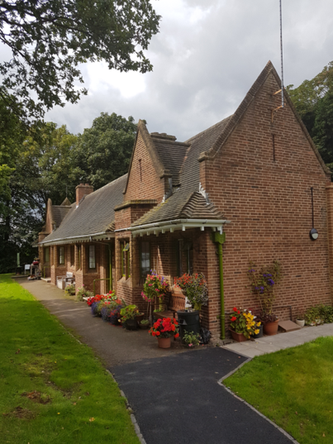
The risks and responsibilities
Each almshouse is expected to manage its scheme efficiently and within the grant rules.
If a scheme fails i.e. fails to meet the requirements of HE/GLA, the grant may be reclaimed
From the almshouse with the failed scheme
From ACL (but not both)
Not from other almshouses

Slide 7
When is ACL at risk?
HE/GLA can only reclaim grant once it has been paid. Therefore ACL and the almshouse concerned is only at risk of a request for repayment after
Start on site claim (for registered providers)
Practical completion for all almshouses
There can be no claim against ACL or the individual almshouses before the grant is paid

Slide 8
How can the risk be managed?
By making sure all schemes submitted for grant payments are sufficiently robust that the grant could not be reclaimed
  Interim audit before start on site claim is lodged
  Full audit before completion claim is lodged
Each almshouse indemnifies ACL against the potential of their grant being reclaimed
  This already exists in the Members’ Agreement
Therefore grant is not claimed, nor a start logged with the grant funder until a successful audit has been achieved.

Slide 9
How grant is paid
1a. Scheme details/milestone provided by Almshouse
2a. Independent Certifier checks audit file
3. Approved by HE/GLA
4. Grant released to ACL’s Solicitor
5. ACL’s Solicitor pays Almshouse
2b. Input by ACL
1b. Audit info provided by Project Manager
Almshouse
ACL
HE/GLA
NB
Registered Providers get a percentage of grant at start and the rest on completion
Unregistered providers get all grant at the end

Slide 10

Types of project eligible for grant
New build
Remodelling
Creation of new units by building from scratch
Or converting from e.g. offices
Grant is only available to registered providers
ACL can help through the registration process
ACL has a suite of policies and forms which have been used by members achieving registration
Regulator is “Regulator for Social Housing”
More than new windows and doors
Must involve some structural change to the building
Including extensions which would (in theory) enable a different client group e.g. couple rather than singles.
Does not require registration with the Regulator
Grant is payable at the end, so this needs to be taken into account in the cash flow for the project
Detail will be looked at by HE/GLA to ensure no repairs are included

Slide 11
Programme and Project Management
Programme Manager
Project Manager
Deals with the programme as a whole
Including bidding for grant
Documentation and liaison with HE/GLA
Inputs and grant payment
Manages ACL accounts and directorships
Organises scheme audits
Undertakes interim audits
Manages the whole development except while Contractor is on site
Provides information to enable inputs and audits to be done
Makes specific recommendations to Trustees including preparing financial appraisals, revenue projections and loan negotiation
Really acts as the ‘right hand’ of the Trustees
Ensures compliance with all requirements

Slide 12
Making things happen
Having a good idea is one thing, getting it to the point where it can be a real project is another.
ACL has been successful in achieving grant funding over a number of programmes, but its reputation depends on being able to do what it says it will do. This means that all projects need to be “deliverable” before a bid is made i.e.
The almshouse already owns the land or has a contract for purchase in place
Planning/Listed Building consent has been granted, or the planning officer has issued a report recommending approval
Apart from the grant all the other funding is in place or loans agreed
Trustees are committed to following the project through to completion, and signing all the documentation necessary.

Slide 13
What’s next?
One of the Programme Managers is available to visit Trustees to
  Go through the processes and look at the project
  Ensure you have an experienced Project Manager in place (or can do this work for you if no-one is appointed)
Your project manager will need to complete a form outlining details of the scheme to ensure
  The scheme qualifies for grant
  All the finances are in place (other than the grant)
  The timescales for start, finish and grant claims are realistic
  The scheme is deliverable!
You need to be sure that Trustees are committed to the project
ACL will submit a bid for funding and, if successful, you will be invited to join ACL

Slide 14
Lunch…….
Questions and Answers
And a chance to chat amongst yourselves!

Slide 15
Thank you for your attention
A GERT HAYKEN Production
for
ALMSHOUSE CONSORTIUM 2016 - 2021

