Slide 1
How to diversify your charity’s trustee board
Sophia Moreau, Associate, Getting on Board

Slide 2
What we will cover today
Trustee diversity: current status
Why does trustee diversity matter?
Inclusion
Practical tips to improve the diversity of your board
How Getting on Board can help
Questions
Notes:
0-5
Welcome
Intro me and GonB
Put in chat pane:
Cause, location
How many trustees vs staff here? Or staff who are trustees elsewhere?
You will be sent these slides – full so can share.
Going to move at pace
Interactive – can make anonymous

Slide 3
Trustee diversity: current status
Notes:
5-10

Slide 4
Who is missing from charity boards? Skills and lived experience
Those with ‘professional’ skills, for example, finance, PR, fundraising, legal, digital, HR and marketing skills.
Service-users/those with “lived experience” of an issue. 59% of charities say that their boards are not representative of the communities they serve.
Notes:
In practice - Homeless charity, or local charity whose board isn’t representative of the local community

Slide 5
Age and gender
The average age of a trustee is 60-62 and only 0.5% of trustees are 18-24, despite making up 12% of the population. 2/3 of charity trustees are over 50. 51% of trustees are retired.
Women are 36% of trustees.
Notes:
Stats for England and Wales from Taken on Trust 2017, commissioned by the Charity Commission. Would expect haven’t changed much and that similar picture in rest of UK.

Slide 6
Race and other protected characteristics
People of colour represent 8% of trustees (vs 14% of wider population).
Other minority groups: disabled people and other minorities are likely to be under-represented (but no stats are available).

Slide 7
Class
30% of trustees have a postgraduate education
60% of trustees have professional qualification
75% of trustees are from households above the national median for household income
Notes:
Trustee body is wealthier and more educated than wider society.

Slide 8
What do we mean by trustee diversity?
Protected characteristics (age, disability, gender reassignment, marriage and civil partnership, pregnancy and maternity, race, religion or belief, sex, sexual orientation)
Lived experience
Class
Neuro-diversity
Geography
? Relevant mix of skills, knowledge, soft skills, perspectives, protected characteristics, experience incl life experience, networks, ways of doing things and so on
Notes:
It is against the law to discriminate against someone because of their protected characteristic(s). Equality Act 2010.
(What is Neurodiversity?
Neurodiversity refers to the different ways the brain can work and interpret information. It highlights that people naturally think about things differently. We have different interests and motivations, and are naturally better at some things and poorer at others.
Most people are neurotypical, meaning that the brain functions and processes information in the way society expects.
However it is estimated that around 1 in 7 people (more than 15% of people in the UK) are neurodivergent, meaning that the brain functions, learns and processes information differently. Neurodivergence includes Attention Deficit Disorders, Autism, Dyslexia and Dyspraxia.
From ACAS )
Broad definition helpful. Partly because not helpful to recruit protected characteristics as separate to everything else.

Slide 9
Charity Governance Code
“The term ‘diversity’ includes the nine protected characteristics of the Equality Act 2010 as well as different backgrounds, life experiences, career paths and diversity of thought. Boards should try to recruit people who think in different ways, as well as those who have different backgrounds.”
https://www.charitygovernancecode.org/en/6-diversity
Notes:
https://www.charitygovernancecode.org/en/6-diversity
Going to be up to you to work out what/who you need on your board.
Go back to what they are hoping to get out of it

Slide 10
Why does trustee diversity matter?
Notes:
10-15
Most of you already sold on this or wouldn’t be coming to this – but helpful to convince others.
Why does it matter?

Slide 11
Charity Commission for England & Wales
“First, charities are missing out on the widest range of skills, experience and perspective at board level. Charities help tackle society’s most important challenges, and work with some of the most vulnerable people in our communities. They are also operating in an environment of increasing public scrutiny. To continue to make an impact for their beneficiaries into the future, and retain legitimacy among the communities they serve, charities need to be smart, agile and creative. A diverse board can bolster a charity’s resilience and give it the best chance of fulfilling its purposes into the future.”
Notes:
https://assets.publishing.service.gov.uk/government/uploads/system/uploads/attachment_data/file/658758/20171113_Charity_Commission_response_to_Taken_on_Trust_research.pdf (Charity Commission response to Taken on Trust report)

Slide 12
Charity Commission for England & Wales
“Second, uniformity at board level puts any organisation in any sector at risk of adverse group dynamics, including group-think, an unwillingness to challenge colleagues, and complacency of vision. Charities are not immune to that.”
Notes:
https://assets.publishing.service.gov.uk/government/uploads/system/uploads/attachment_data/file/658758/20171113_Charity_Commission_response_to_Taken_on_Trust_research.pdf (Charity Commission response to Taken on Trust report)

Slide 13
Charity Governance Code
“Diversity, in the widest sense, is essential for boards to stay informed and responsive and to navigate the fast-paced and complex changes facing the voluntary sector. Boards whose trustees have different backgrounds and experience are more likely to encourage debate and to make better decisions.”
https://www.charitygovernancecode.org/en/6-diversity
Notes:
https://www.charitygovernancecode.org/en/6-diversity
Go back to what they are hoping to get out of it

Slide 14
Evidence that diverse boards:
Present more options and are more innovative
Analyse the evidence more carefully
In the commercial world, make more money
https://hbr.org/2016/11/why-diverse-teams-are-smarter
Notes:
Common sense says the same
= good governance

Slide 15
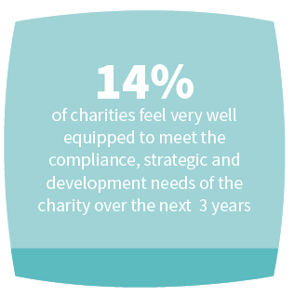
Notes:
Evidence that boards don’t feel well equipped currently – GonB research 2017

Slide 16
Take aways: why diversify your board?
Challenge and difference are at the very heart of effective governance.
Research shows that a relevant mix of people on our boards is one of the primary ways of building organisational resilience.
As trustees, it is our legal responsibility to do our best by our organisation and a lack of diversity on a board is a risk.
Boards should be close to the changing needs of current and potential service users.
Why miss out on all of that talent?!
Board diversity is essential for credibility.
Notes:
Missed anything major?

Slide 17
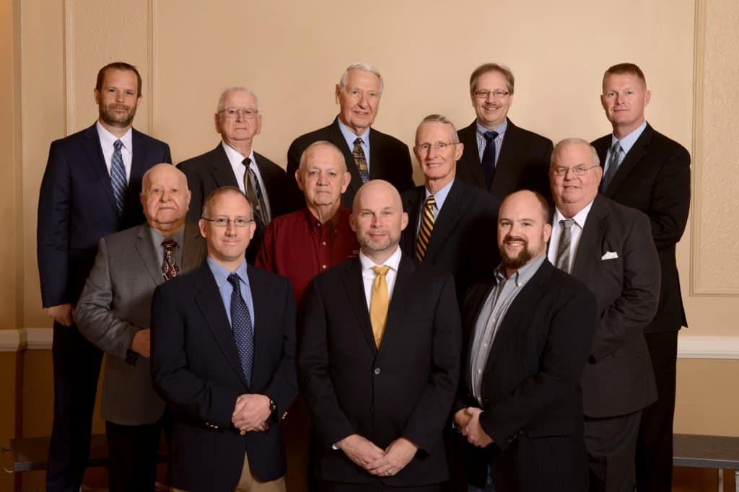
Notes:
Real board – US
What would a grant-making trust think of this board, if applying for funding for a programme for young women?
Or a potential female donor? Or a young person selecting a charity to do a fundraising challenge for?
Or even someone thinking of coming to your charity for help?
Not about how boards look – this can lead to recruiting to the wrong reasons – but it is about connection with potential service users, funders, donors etc.

Slide 18
Inclusion
Notes:
15-20

Slide 19
“Diversity doesn’t matter as much on boards where members’ perspectives are not regularly elicited or valued. To make diverse boards more effective, boards need to have a more egalitarian culture — one that elevates different voices, integrates contrasting insights, and welcomes conversations about diversity.”
https://hbr.org/2019/03/when-and-why-diversity-improves-your-boards-performance
Notes:
Recruit for the right reasons, because you genuinely want to listen to and act on diverse perspectives.
Otherwise, don’t bother – you won’t get the benefit of a diverse trustee and they may not stay.
If you do have trustees who are “different” to their colleagues, do they contribute as much as the other trustees? Are they being listened to? Are they sticking around? If not, the problem is most likely at your end, not theirs.
Some board behaviours can be excluding
Over-familiarity
Jargon/history
I.e. getting your board ready – chair critical
THIS IS THE HARDEST ASPECT OF ALL OF THIS – JOURNEY, ASK FOR FEEDBACK, LEARN

Slide 20
“I left a trustee style role because I felt intimidated around lots of white people. Your voice is undermined and you feel like a minority. If you ask too many questions you feel like you are being demanding. It also just felt like a tick box exercise. I was like a silent member of the board. There were a lot of power dynamics due to race issues.”
Notes:
GonB research, spring 2020 – many comments like this.
Experiences personally harmful.

Slide 21
Practical tips to improve the diversity of your board
Notes:
20-40
8 tips
Attainable, simple, don’t need to cost lots of money.

Slide 22
Tip 1
Run an open recruitment process
Notes:
There is a direct correlation between rigorous, open trustee recruitment and success in recruiting a diverse board with the skills, knowledge and experience that a charity needs
Tested and proved this assertion through a programme called Trustee Recruitment Pathways.
100% successfully recruited
Before the programme, 57% of charities felt their board was representative of their service users. This increased to 70% after the programme.
65% felt their board was more diverse now.
Before the programme, 43% of participating charities felt well-equipped to deal with the challenges the charity was facing. This increased to 85% at the end of the programme.

Slide 23
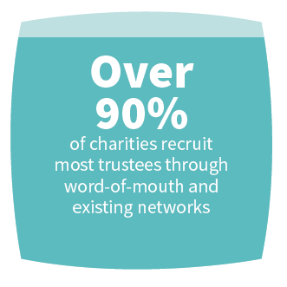
Notes:
NCVO - 10% of vacancies ever advertised
54% of charities advertise their trustee vacancies on their own website.
Method of recruiting:
Recruit more people like us
Restricts pool of applicants

Slide 24
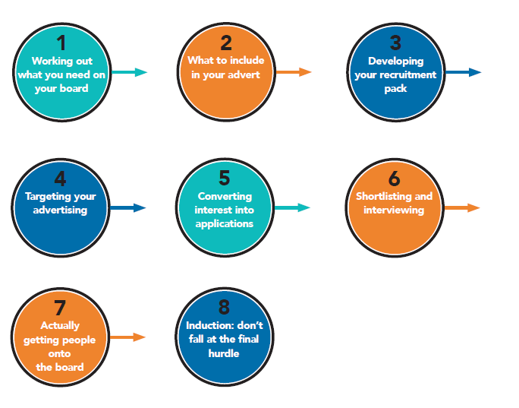
Notes:
Like recruiting staff and volunteers – timely, slick, organised.
Tell people where they in the process and how long it is going to last. What’s going to happen.
This process is good for all trustees! As are all of the tips I will speak about.
Who should be leading the process – not just CEO or a single trustee. More likely to have bias if led by one person.

Slide 25
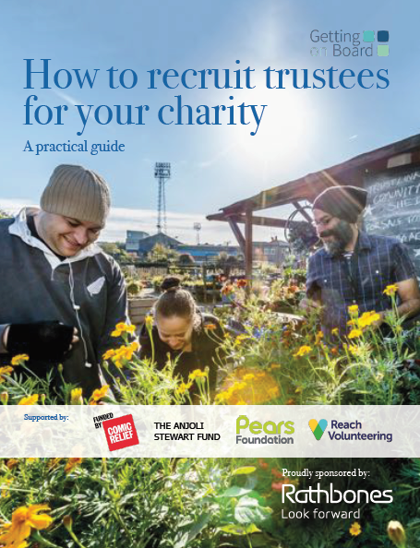
Notes:
Also, templates on our website

Slide 26
Tip 2
Recruit at the confluence of diversity and skills/knowledge/experience
Notes:
Sweet spot – work out what missing in terms of skills/knowledge/experience first
Intersectionality

Slide 27
What challenges and opportunities is your charity likely to face over the next 5 years?
Do your trustees have the right skills, knowledge, experience, backgrounds to tackle these challenges?
If not, what’s missing?
Notes:
Recap how to work out what missing.

Slide 28
Tip 3
Remove all unnecessary barriers
Notes:
So pool not restricted
You decide what is necessary

Slide 29
Remove barriers which will restrict your pool of applicants
Do they need board experience/a degree?
Do they need a detailed understanding of charity governance/an “understanding of their legal responsibilities” or can training be provided?
Are you using gendered language? Use online ‘gender decoder’ tools to check.
Use “at a senior level/significant senior experience” with care.
Practicalities: meeting times and locations, expenses
Does the time commitment have to be the same for everyone?

Slide 30
Don’t assume that people don’t want to become trustees
Participants across both focus groups rated the following as the primary barriers to becoming a trustee: “I am concerned about not getting my voice heard”; “I don't feel qualified to be a trustee”; “I don't want to take on a responsibility that I don't understand” (yet, when we asked them to describe what trustees do, their understanding was good); and “I need to find a charity I connect with”.
The lowest ranked barrier was “I don't think being a trustee would be an enjoyable experience”. Indeed, several spoke powerfully about how they would find it fulfilling.
Notes:
Getting on Board focus groups, spring 2020 with young people and people of colour.
Time was middle ranked

Slide 31
Don’t assume that potential trustees know:
That they want to be a trustee!
That trusteeship is open to them
What a trustee is
Anything about your charity
How to apply
What a typical trustee recruitment process is
How to behave as an effective trustee (many existing trustees don’t know this either!)

Slide 32
(Trusteeship is) “bestowed upon people when they have a lot of influence, power and success: I didn’t know you could apply to be a trustee”.
“I see it as an older white male scenario – I don’t fit into that category.”
Notes:
GonB focus groups – very common incl in people very senior in their day jobs.

Slide 33
Tip 4
Get your advert right

Slide 34
“The Role
Support the Director in implementing the organisational vision and strategy.
Be a company director of xxx fulfilling all the statutory requirements of that role and complying with the requirements under the Companies Act 2006.
Actively fulfil the duties of a charity trustee and be familiar with these responsibilities…”
Notes:
These are real examples and excerpts, anonymised. Good for them for advertising.
Chat pane:
What here would restrict applicant pool
Ad not role description

Slide 35
“This is an exciting opportunity for three senior professionals ... to join xxx as a Trustee. In 2020 we are seeking applications to fill four vacancies on xxx’s Trustee Board with high calibre of people…”
Notes:
Chat pane:
What here would restrict applicant pool

Slide 36
What to include in your advert
What your charity does
What skills and experience you’re looking for and why
What a trustee does
What the time commitment is
Any benefits – out of pocket expenses, training
Where the meetings are held
How to find out more information
How to apply
Closing (and interview) dates
Notes:
Avoid jargon. State the obvious.
Not going to talk about info packs but the same rules apply.

Slide 37
Explain what a trustee is
“Trustees have overall control of a charity and are responsible for making sure it’s doing what it was set up to do. They may be known by other titles, such as: directors; board members; governors; committee members.
Whatever they are called, trustees are the people who lead the charity and decide how it is run.”
(The Charity Commission)
Notes:
https://www.gov.uk/guidance/charity-trustee-whats-involved (CC3A)
One of our training attendees came up with: “Our staff do the day to day work but we need trustees to shape what we do and make sure we do the best job we can”.

Slide 38
Possible advert wording
“It is not necessary to have previous board committee experience as training will be provided. This position would therefore suit an individual taking their first steps to develop wider board level and governance experience.”
(Sense about Science)

Slide 39
Possible advert wording
“Previous board/trustee experience is not necessary and we welcome applications from all ages and backgrounds.”
“We particularly welcome applications from (women, people of colour, under 30s, people with lived experience of homelessness….) as we are looking to diversify our board.”

Slide 40
Tip 5
Do the leg work to advertise where your potential trustees will see it

Slide 41
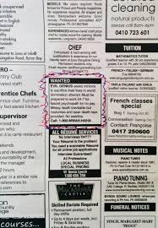
General

Slide 42
Trustee listings websites
Reach: https://reachvolunteering.org.uk/charities-non-profits/find-trustee
Do-it/Small Charities Coalition: https://do-it.org/channels/trustee-finder
Women on Boards: https://www.womenonboards.net/en-GB/Home
Young Trustees Movement: https://youngtrusteesmovement.org/
Getting on Board: www.gettingonboard.org (not a listings website)
Charity job: https://www.charityjob.co.uk/
Notes:
All free

Slide 43
Other places to advertise
Your own website, social media, newsletter
Newsletters, e-magazines
Posters in hospitals, universities etc
Volunteer Centre / CVS / membership bodies
Twitter, Facebook, Linked In etc
Notes:
Shortcomings of these – people have decided they want to be trustees (a positive there too!)
BUT THESE ARE STILL QUITE GENERIC. SO THINK MORE TARGETED TOO.

Slide 44
Targeted
Notes:
Coming up next are examples of targeted platforms you can use

Slide 45
Where will you find trustees with the skills you need?
Workplaces/large local employers
Business parks
Business networks/membership bodies
Professional associations
Accountants - http://www.icaewvolunteers.com/
Treasurers - http://www.honorarytreasurers.org.uk/Vacancies1.html
Lawyers - https://www.barprobono.org.uk/
HR - https://peoplemanagement.haymarketrecruitment.com/register/
Publications, websites, online networks
Notes:
To get to people not already looking to be a trustee.

Slide 46
Example professional networks built around protected characteristics
Black Fundraisers Network: https://www.institute-of-fundraising.org.uk/groups/sig-black-fundraisers-network/
Women in Banking and Finance: https://www.wibf.org.uk/
Black Young Professionals: https://byp-network.com/
Black Solicitors Network: https://www.blacksolicitorsnetwork.co.uk/
International Association of Young Lawyers https://www.aija.org/en/
Notes:
To get to people not already looking to be a trustee
Gatekeepers
Many paid platforms too

Slide 47
General
Our website
Our LinkedIn
Our Twitter
Tag relevant orgs through LinkedIn and Twitter
UK Charity Trustees Linkedin group
Reach
Charity Connect
Charity Job
Do-it
Our corporate partners
GonB vacancy list
Team London
The Fore
TPP (free service)
Ethical Angel
Digital marketing
Media Trust
Charity marketing group on Facebook
LinkedIn group: “Charity Digital Marketing Jobs”
CIPR
Charity Comms
CSR
ICRS
Corporate Citizenship
LinkedIn group: “Investors in Community”
Impact and campaigning
IVAR
Social Change Agency
Infrastructure and funders
Association of Charitable Foundations
NAVCA newsletter
BAME contacts list
Aleto Foundation
Asian Business Association (ABA)
Black Collective of Media in Sport
Black Fundraisers UK
Black Young Professional Network
Muslim Women's Network UK
National Black Women's Network
Powerful Media
(Thanks to the Action for Trustee Racial Diversity)

Slide 48
Tip 6
Shortlist and interview fairly and objectively

Slide 49
Shortlisting
Decide who is going to shortlist
You could anonymise applications to minimise ‘unconscious bias’.
Make sure you are clear on the criteria you are assessing – essential vs desirable
Ensure that the criteria don’t disadvantage the groups you are trying to attract
Set scores, eg. out of 5 for match to each competency you are looking for.
Notes:
CEO recruiting own boss

Slide 50
Interviewing
Tell process in advance and stick to it / help candidates be their best
Accessibility
Panel diversity
Use set questions for all candidates – can delve deeper if need to
Don’t assume or test things that can be learned (e.g. role of trustee)
Two way interview
Notes:
If time: terrible interview questions.

Slide 51
Tip 7
Induct, induct, induct
Notes:
Induction – What would you include?
Buddying
Training – internal and external
Ask people what they need, don’t assume you know
Recruit multiple new trustees at once
Less work for you
More likely to speak out
Don’t treat people as “the BAME trustee” etc. People don’t always want to speak for their communities unless you are specific about that when you recruit (and clumping all people of colour together is a nonsense). Treat BAME trustee like a set role.
Also, don’t ask people to lead on D&I unless they offer or you have specifically recruited them under that remit/for their professional expertise in that area.
What can include:
Meet with board
Time with Chair
Meet with key exec staff
Experience organisation’s activities
Explain organisation’s history, work, current priorities/challenges, acronyms (!), key stakeholders, external environment
Docs:
Board terms of reference, roles and responsibilities, board code of conduct
Strategy
Governing documents
Recent minutes
Financial information / annual report and accounts
Signpost Charity Commission guidance

Slide 52
Tip 8
Just do it
Notes:
Concern re wrong terms, doing it wrong – best just to go for it.
Be honest that you are learning and encourage feedback.
Issue of guilt/defensiveness – lead from the front.
If time, comments on this. What would stop you recruiting?

Slide 53
How Getting on Board can help
Notes:
40-45

Slide 54
Transform
A trustee recruitment programme for charities who wish to take action to diversify their board. £1,550.
We will teach you how to recruit and retain diverse trustees, and guide you through a live trustee recruitment process. You will recruit new trustees between October 2021 and March 2022.
Pre-register here: https://www.gettingonboard.org/transform
Notes:
Transform
​
An introductory webinar for up to 10 members of your board and senior exec outlining the programme and explaining the board’s role in trustee diversity and inclusion. This webinar will be for all 16 organisations and a recording will be available for any of your trustees or staff who can’t attend the live session
Five online, live masterclasses (1.5 hours each) for one or two members of your board or senior staff team, taking you through the implementation of your recruitment campaign. You will learn alongside 15 other charities. At least one representative should attend every masterclass.
One-to-one support and coaching from Getting on Board throughout the recruitment process.
Drop-in clinics to support with any issues during the recruitment process.
You will recruit new trustees. Please note that Getting on Board is not a recruitment agency and we will not recruit trustees on your behalf. We believe that by showing charities how to recruit effectively, it will equip them to establish and maintain board diversity and inclusion.
Some centralised advertising to potential candidates by Getting on Board (but please note that you will be primarily advertising yourselves, with our guidance).
An optional closed session for your board on their role in inclusive governance.
Optional induction training (two one-hour webinars, at fixed times with the new trustees from the rest of the cohort) for your new trustees. Recordings will be available for those who can’t attend live.

Slide 55
Training
Training incl:
Festival of Trusteeship
Inclusion training
Sign up to our newsletter: https://gettingonboard.us19.list-manage.com/subscribe?u=f194491b52db7cc118f78b563&id=08980a088e

Slide 56
Questions
Notes:
45-60

