Slide 1
Mergers and Takeovers for Almshouses
Nick Burrows, Tim Clark and Katja Wigham

Slide 2
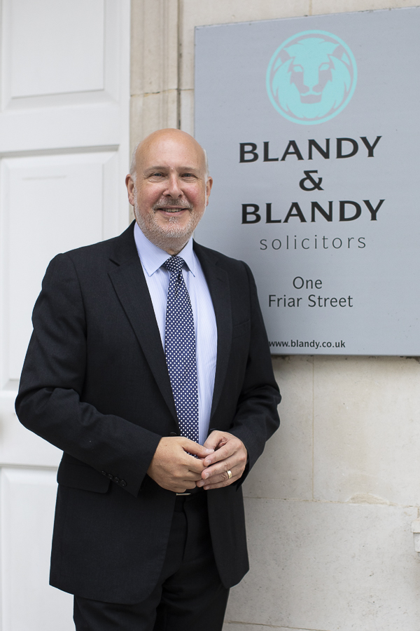
About Blandy & Blandy
Based in the Thames Valley.
Advise national and local charities, including a growing number of Almshouse charities.
Provide a comprehensive range of legal services.
Recommended in Chambers UK and The Legal 500.

Slide 3
What we will cover
Initial considerations
Charity law matters
Ways to merge
The process
Employment issues
Property matters
Your questions

Slide 4
Charity Law & the Process
Nick Burrows
Partner
nick.burrows@blandy.co.uk

Slide 5
Initial considerations
Why is the charity considering a merger?
What problems are being experienced?
What other options have been investigated?
Is it struggling financially or for some other reason?
Does it wish to expand its reach?
How will the merger benefit the charity and its beneficiaries?

Slide 6
Charity law matters
The first step is to consider the charity’s governing document – does it give trustees the powers to amalgamate/merge their charity?
Almshouses are generally governed by Charity Commission Schemes.
They often do not contain a power to merge.
If the incomes are small enough, it could be possible to use the small charities provisions in the Act.

Slide 7
Charity law matters
If the charities are too big (income of more than £10,000) to use those provisions, a Scheme or Order from the Commission will be required.
The next question is whether the objects of the two charities are similar/the same.
If they are, then the Commission can use s105 to make an order for the transfer of assets.

Slide 8
Charity law matters
If the objects are not similar/the same, then the trustees will need to make a case for the merger under s62 (1) of the Act (under the doctrine of cy-près).
If that isn’t possible, the Commission may be able to issue a uniting direction to consolidate the charities.

Slide 9
Charity law matters
The key point is that it is generally less straightforward for Almshouses than for a lot of other charities to effect a merger because of the wording of their Schemes.
It is therefore sensible to get advice early in the process to determine how best to proceed.

Slide 10
Ways to merge
There are, generally, three ways to effect a merger of two charities:
To form a new charity and for both merging charities to transfer all of their assets and liabilities to it
For one charity to acquire the assets and liabilities of the other
For one charity to become the sole trustee of the other

Slide 11
Ways to merge
The third option can be useful to bring together charities under unified administration whilst retaining their separate objects.
The first is generally not appropriate or necessary.
The second option is the more common route.

Slide 12
The process
Assuming that the second option is chosen, and that the consent of the Commission has been obtained then:
An asset transfer agreement, or merger agreement would be drawn up.
Due diligence would start (and each party would probably want to carry out due diligence on the other).

Slide 13
The process
Due diligence is often time consuming and needs to be detailed and comprehensive.
It comprises detailed investigations into all of the assets and liabilities of the merger partner and an evaluation of the risks and benefits of the merger as a result of the information disclosed by that process.

Slide 14
The process
Often the two areas that merit the most detailed investigation are:
Employees of the charity; and
The charity’s property/ies.

Slide 15
Employment Law
Tim Clark
Partner
tim.clark@blandy.co.uk

Slide 16
Employment Issues
What about the people working for the merging entities?
Big question – Do the Transfer of Undertakings (Protection of Employment) Regulations 2006 – TUPE - apply?
Product of EU Directive.
Around since 1981 not going anywhere.
Aimed at the Protection of Employees in situations where:
one business takes over another or part of another; or
a service is being provided and that service is outsourced or insourced by a client or is the subject of a change in service provider.
Not aimed at helping employers.
Cannot contract out.

Slide 17
Key provisions of TUPE
Employer obliged to inform and consult with Employee Representatives re the transfer – penalty for failure up to 13 weeks full pay per employee .
Employees entitled to transfer to the Entity which will continue in existence:
On same terms (with protection from changes).
With same employment protections.
With dismissal being automatically unfair if it is because of the transfer.

Slide 18
Our scenarios
Scenario 1 – Charity C is to be formed as a new entity and will take over the business of Charity A and Charity B.
Scenario 2 – Charity A will continue but take over the business of Charity B which will cease to operate.
Scenario 3 – Both Charity A and Charity B will still exist but A will become sole trustee of B.

Slide 19
Our scenarios
In each scenario Due Diligence on the employees of the charity being taken over or with which you are joining is crucial.
Terms of employment, history of disputes etc.
Regulation 11 of TUPE provides its own framework.
But does TUPE apply?

Slide 20
Scenario 3 – Charity A becomes sole trustee of Charity B
The easy one - TUPE does not apply.
Employees remain employed by their existing employer on existing terms with existing rights.
No obligation to inform the employees or consult with them.
Does the new shareholder want to make changes?
Provided the original entity is going to continue carrying out its business – just managed as normal – e.g. executives manage issues such as redundancy as normal.
But… if new trustee later takes over the business or some part of it, TUPE may be triggered at that point.

Slide 21
Scenario 2 – Charity A will continue but take over the business of Charity B
A TUPE transfer from B to A.
Charity B is obliged to undertake process of information and consultation with its employees via representatives.
Charity A is obliged to provide information to Charity B about any plans which might impact on employees.
Unless object to transferring, Charity B’s employees will transfer to A on same terms and conditions and with preserved employment rights.

Slide 22
Scenario 1 – Charity C is to be formed as a new entity and will take over the business of A and B
Two TUPE transfers one from A to C and one from B to C.
A and B both obliged to undertake processes of information and consultation with their employees.
Again unless they object to transferring, employees will transfer to C on same terms and conditions and with preserved employment rights.

Slide 23
Making changes to the workforce post a TUPE transfer
Obviously a key driver may be efficiencies in terms of staffing.
TUPE provides that a dismissal will be automatically unfair if the TUPE transfer is the reason for it.
Unless
Economic, Technical or Organisational reasons entailing changes in the workforce.
Seems a wide exception but “entailing changes in the workforce” is a limiting factor.
In most cases need a redundancy scenario to pass.
Re-arranging employees and changing their terms not be enough.

Slide 24
How long do you have to wait after a transfer before you can make changes?
Time helps but no time limit.
Beware – in general terms you cannot try to offer different terms which are better in some respects and worse in others and expect that to work - Employer bound by improvements but TUPE protects against negative changes.
Exception - terms agreed on a collective basis may be replaced with alternatives which are overall no less favourable after 1 year.
Natural evolution of the business.

Slide 25
Property
Katja Wigham
Partner katja.wigham@blandy.co.uk

Slide 26
Property matters
The key is early due diligence whichever structure is chosen.
However; it is possible that the nature of the property will impact on the available structure and so finding out more about the properties early on is vital.

Slide 27
Nature of the property
Permanent endowment/in specie-if yes this may mean option 3 is the required structure.
Are the properties freehold (most likely) and are they registered at the Land Registry? If they are unregistered, does the Charity have the title deeds? Is there a good root of title?
If the transferring charity is unincorporated are the properties registered in the names of the current trustees? –this is quite often not the case and can cause substantial delay to the transaction.
Are there any other restrictions on the properties which would prevent a transfer? e.g. covenants/rights of pre-emption.
Are any of the properties charged?

Slide 28
Nature of the property
Does the Charity own properties other than the Almshouses? e.g investment properties or an office?
If yes, are any of these leasehold and does the lease allow for a transfer?
If yes, are any of those properties subject to tenancies and are there any rent arrears or other breaches of covenant such as dilapidations?

Slide 29
Due diligence
Condition
Are the properties in a good condition? Obligations regarding maintenance and repair of Almshouses.
Likely future expenditure.
Regulatory
Are there any regulatory breaches - e.g. lack of asbestos (in common parts/commercial investment properties) or fire risk assessments, breaches of planning conditions.
What are the energy performance ratings/Do the minimum energy efficiency standards apply? A grey area for Almshouses.

Slide 30
The process
Searches - minimum local, environmental, drainage and chancel.
Enquiries.
With option 1 and 2 - transfer. Only due diligence required for option 3.
Leasehold properties may require a Landlord’s licence to assign and notice following completion.
Properties subject to tenancies may require assignments of rent deposits/rent arrears and notices to each Tenant.
Stamp Duty Land Tax (SDLT) - with a transfer to another charity not for value this should not be relevant.
Registration at the Land Registry:-
Unregistered land-will trigger first registration.
Fee payable on value of properties transferred at a reduced rate.

Slide 31
Thank you Any questions?
Nick Burrows Charities & Commercial nick.burrows@blandy.co.uk | Tim Clark Employment tim.clark@blandy.co.uk | Katja Wigham Commercial Property katja.wigham@blandy.co.uk

