Slide 1



WHAT IS THE DIGITAL SWITCHOVER?

Slide 2
What is happening?
By 2025 the traditional telephone network – analogue or Public Switched Telephone Network (PSTN) will be switched off and upgraded to newer digital technology – Voice-Over Internet Protocol (VoIP).
Internet connectivity will be enabled on every telephone line and calls will be sent using digital signals.
The upgrade will simplify management of the telephone exchanges and make it easier for the telecoms companies to provide newer services in the future.

Slide 3
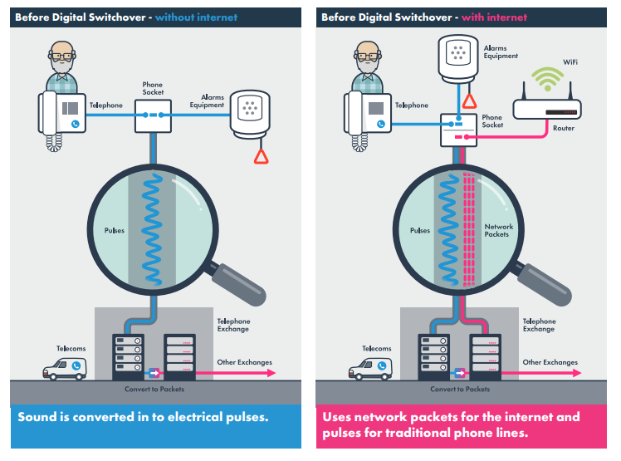
How do telephone lines work now?

Slide 4
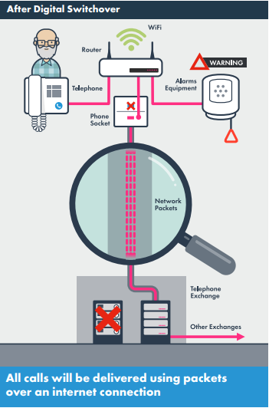
How will telephone lines work after the Digital Switchover?

Slide 5
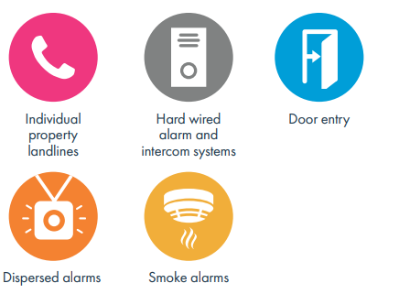
Why some alarms equipment might not work post Digital Switchover
For social housing providers, there will be significant implications for sites where a hard-wired alarm, warden intercom or dispersed alarms are in place.
These older systems were not designed to work with internet technologies and any analogue equipment may not work reliably 100% of the time or even at all post Digital Switchover.

Slide 6
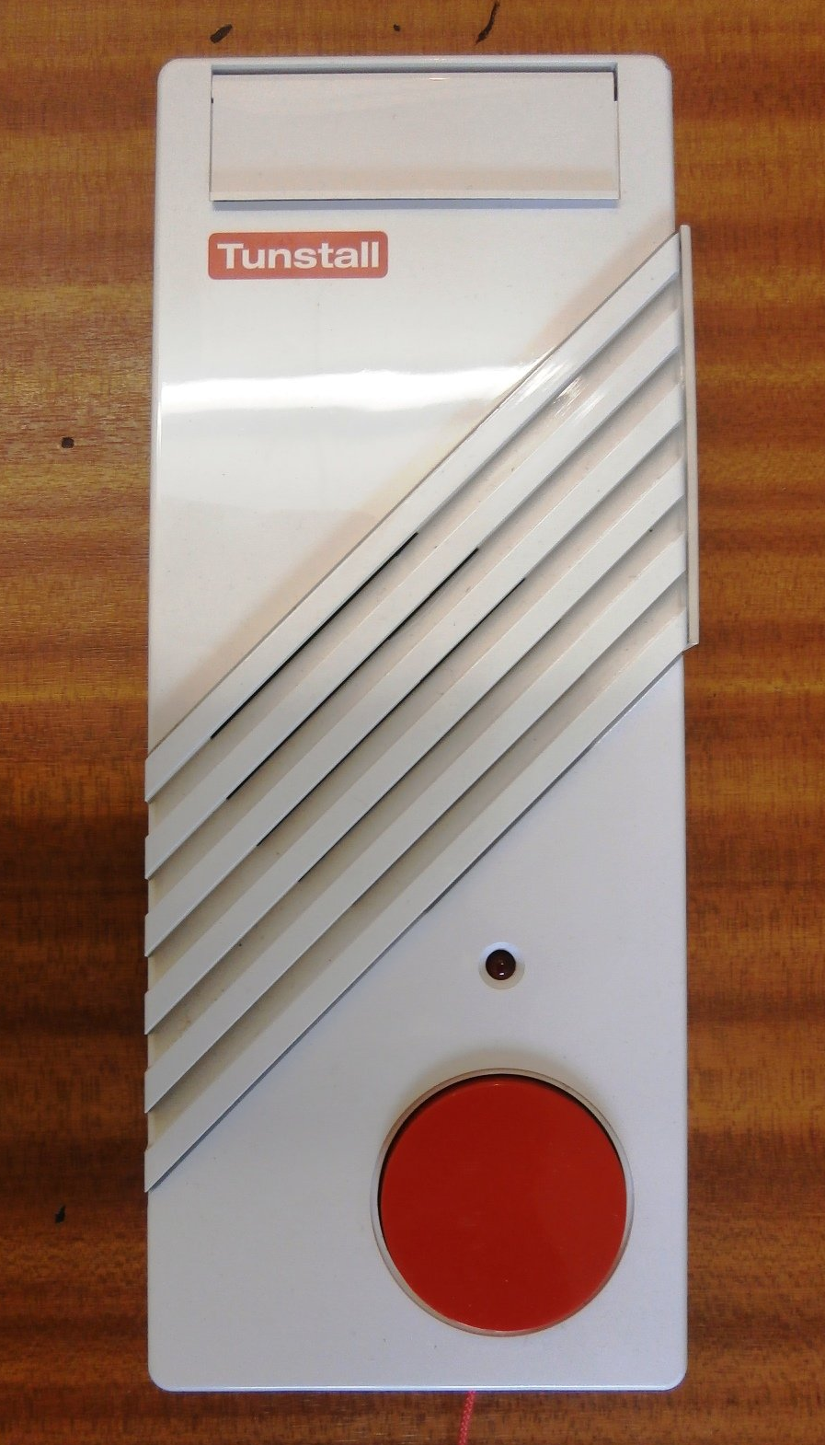
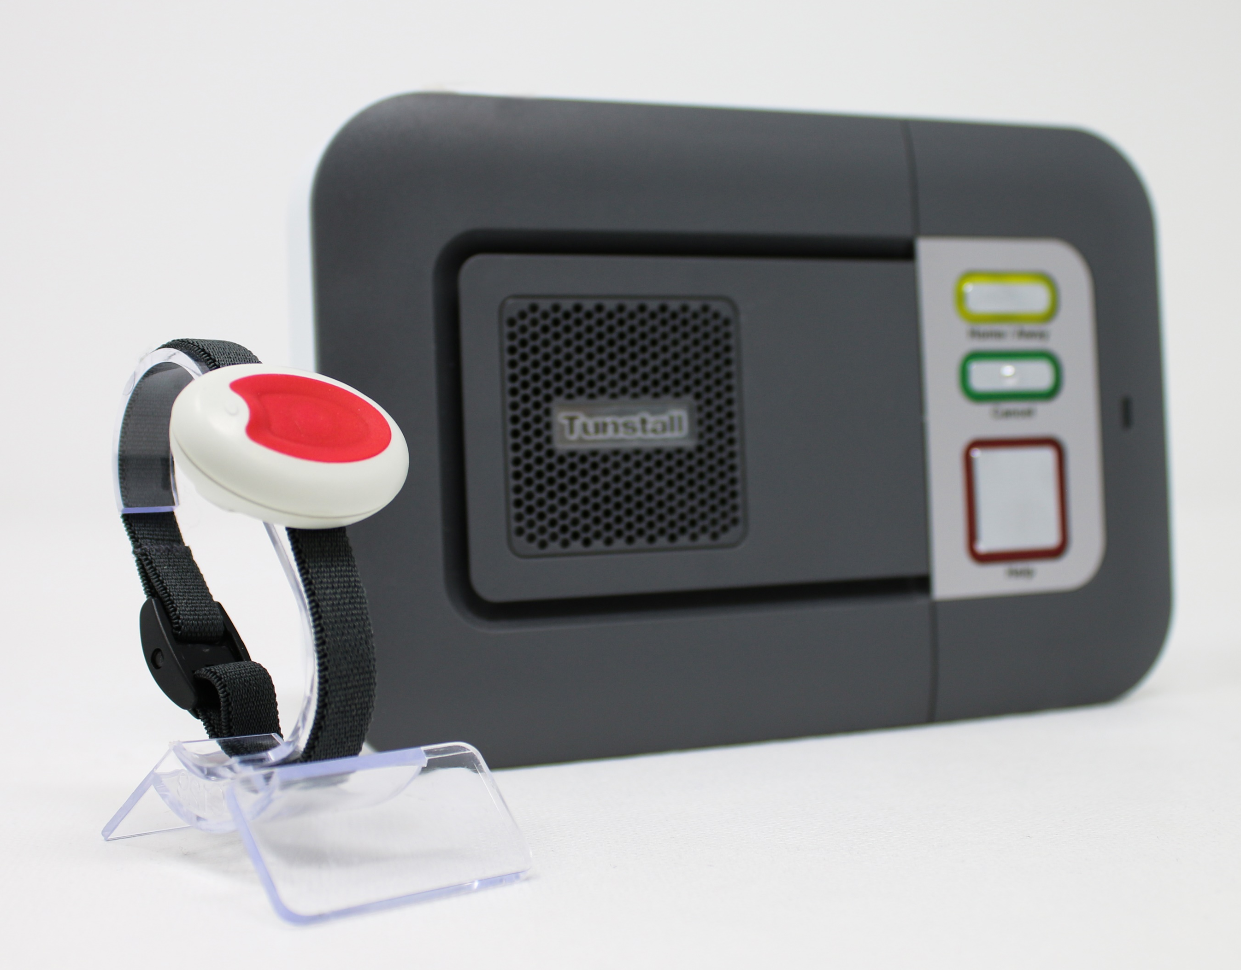
In simplified terms, the way an analogue alarm communicates is the same as an analogue telephone in that it sends it’s message in a series of beeps or tones which will need to be converted into digital ‘packages’ over the internet to reach an Alarm Receiving Centre.

Slide 7
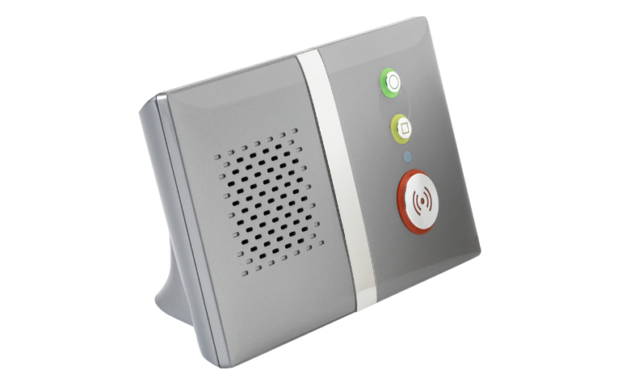
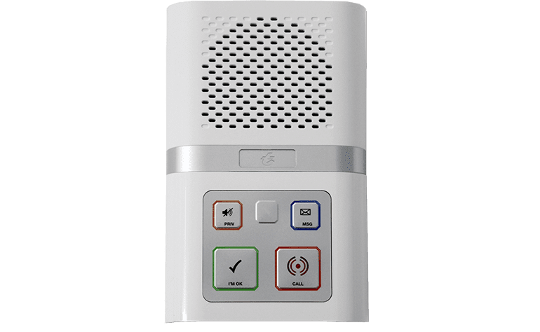
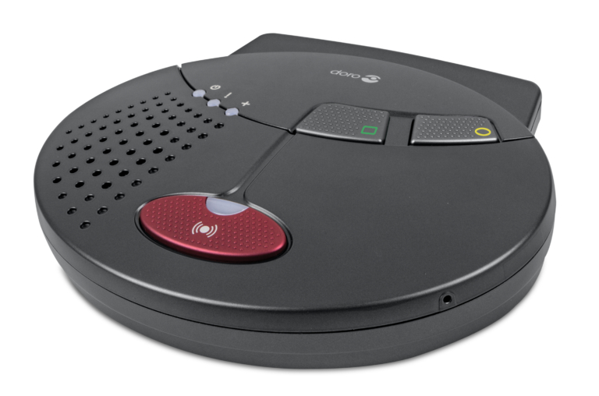
This creates a risk that an ARC receiving a call from an alarm system might not sometimes be able to recognise the tones played if any of these packets are delayed, or for some reason do not arrive due to a technical fault, even by only fractions of a second.

Slide 8
Are we on track for the transition to digital telecare?
2025 switch-off – a hard deadline.
First time call failure rates are a clear example of the necessity for action.
An estimated 125 housing developments are upgraded to digital every month.
At this rate, 6,250 developments will have been upgraded by 2025.
With approximately 25,000 developments in the UK, only 25% of the requirement to ensure all customers have a safe, reliable alarm system will be fulfilled.
There needs to be an approximate five-fold increase in the pace of upgrades to ensure a majority of customers have access to digital telecare.

Slide 9
Digital telecare, what are the barriers?
“The technology will be better next year”
“The immediate cost is too high and it’s difficult to build the business case”
“The analogue only capabilities of some suppliers and ARC’s is reducing choice”
“Yes, but that will always be the case with technology, you can’t wait forever”
“Are you considering the whole life cost and new financial models”
“True, but choice today is different and there broader”

Slide 10
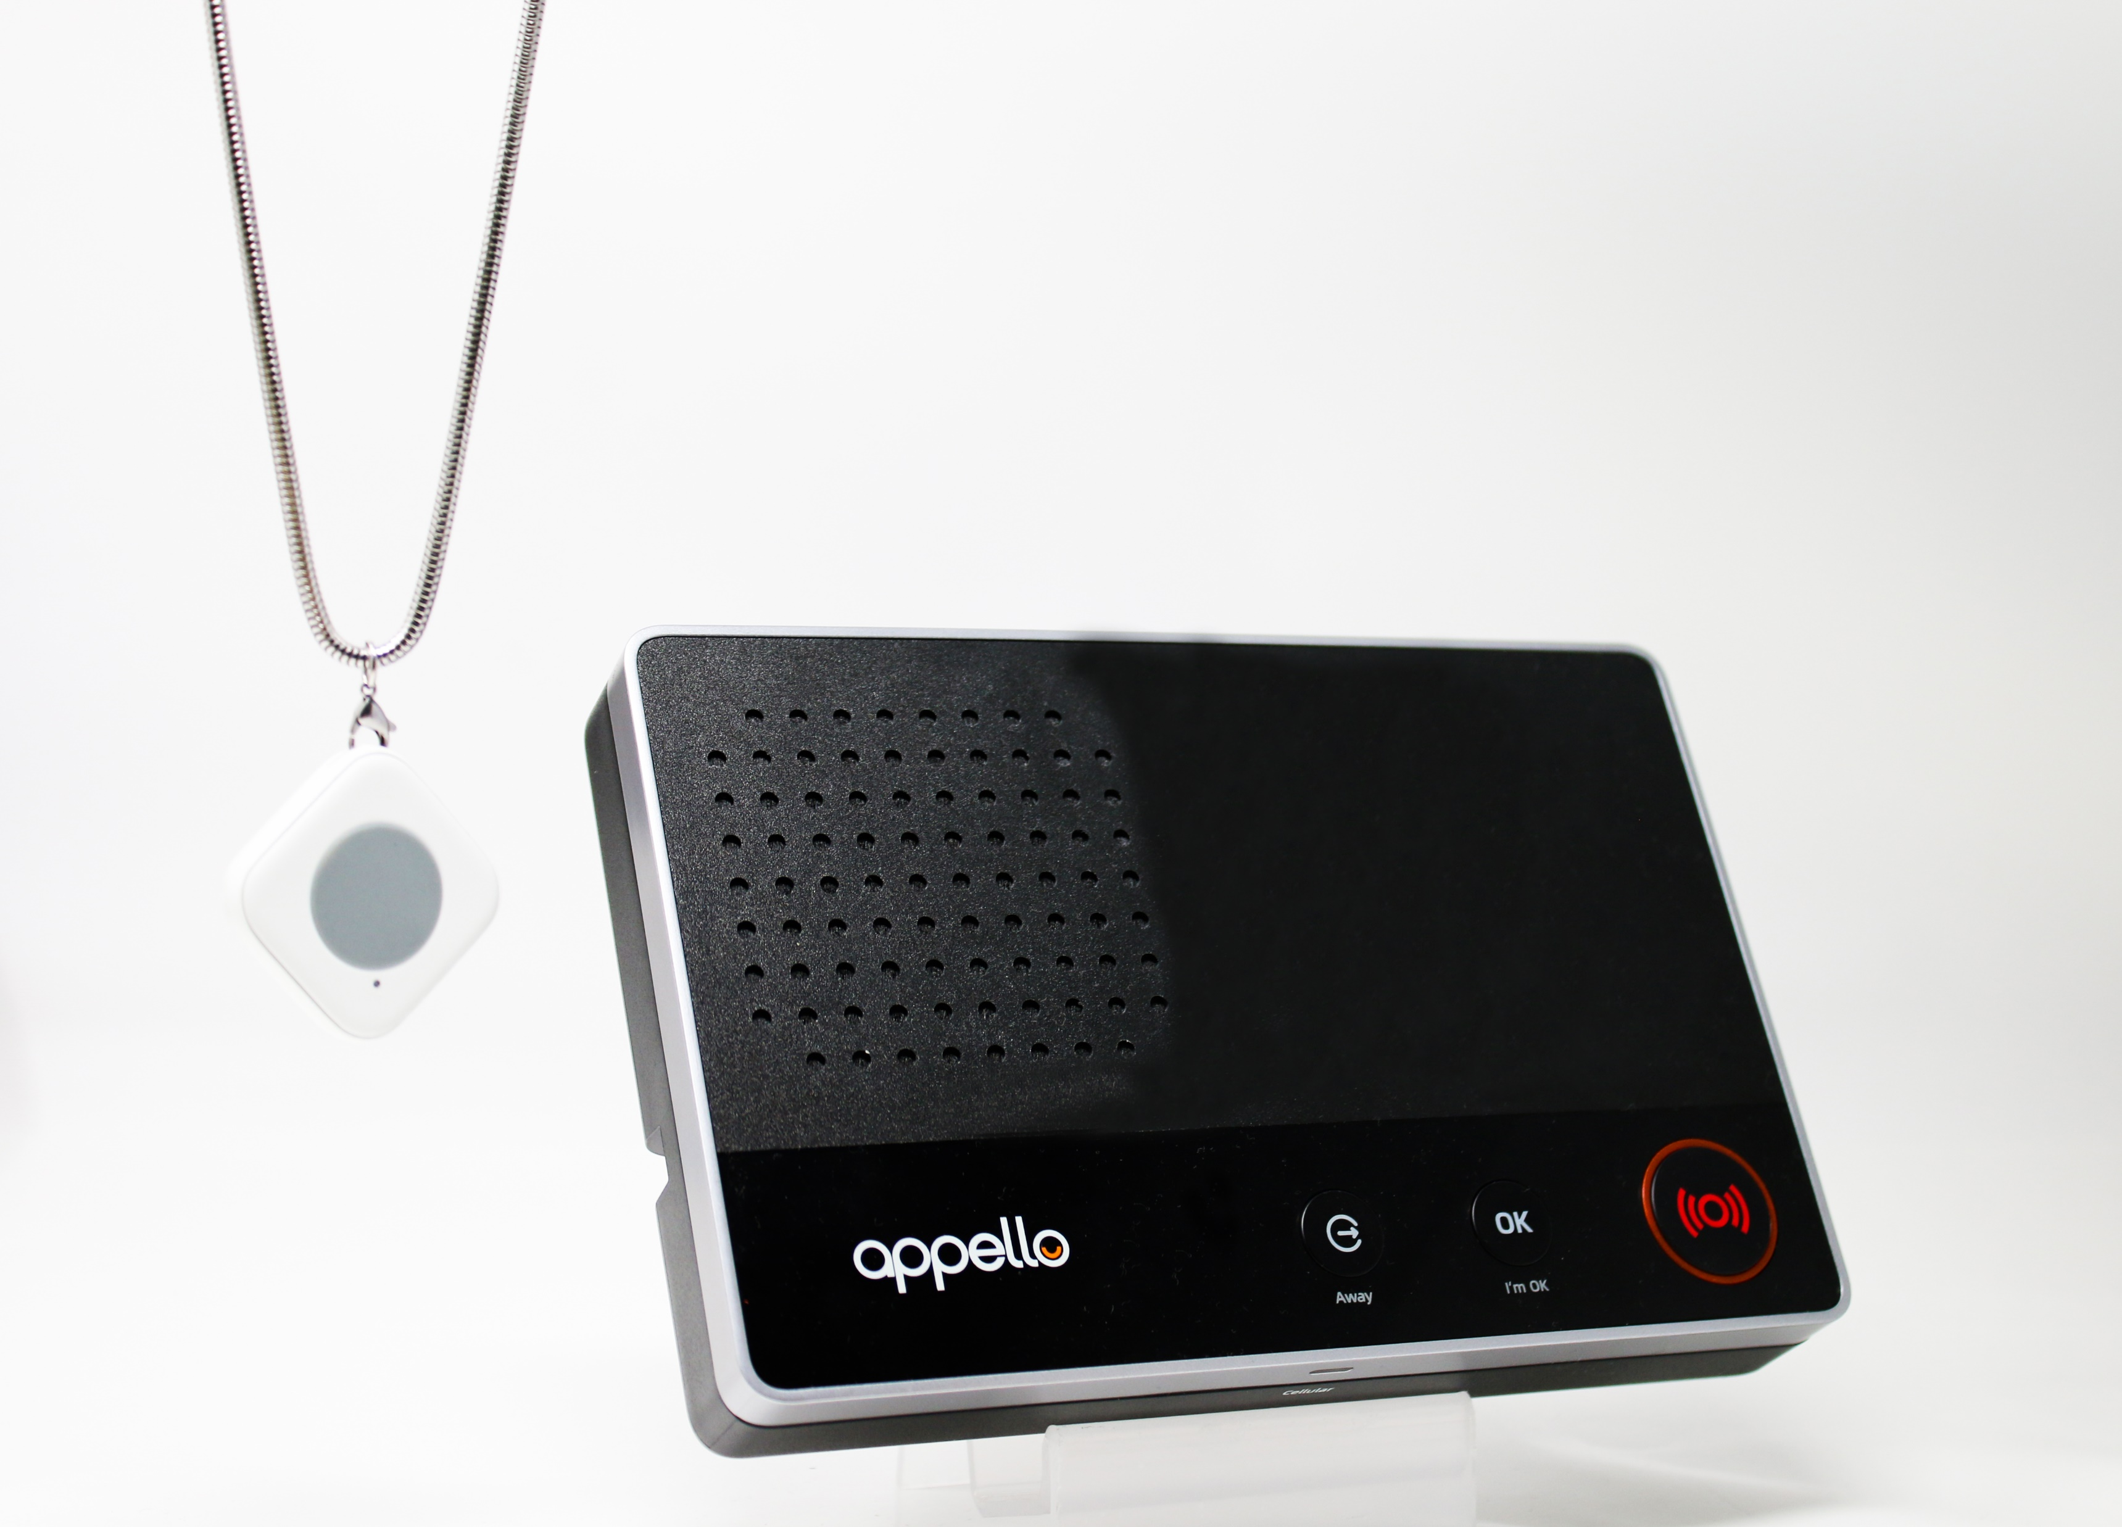
Careline Digital Alarm Solution
No phone line needed
Roaming SIM Connection
Still functional in a power cut
Simplest installation process - only one wire to plug in
Waterproof pendant with range of up to 300m

Slide 11
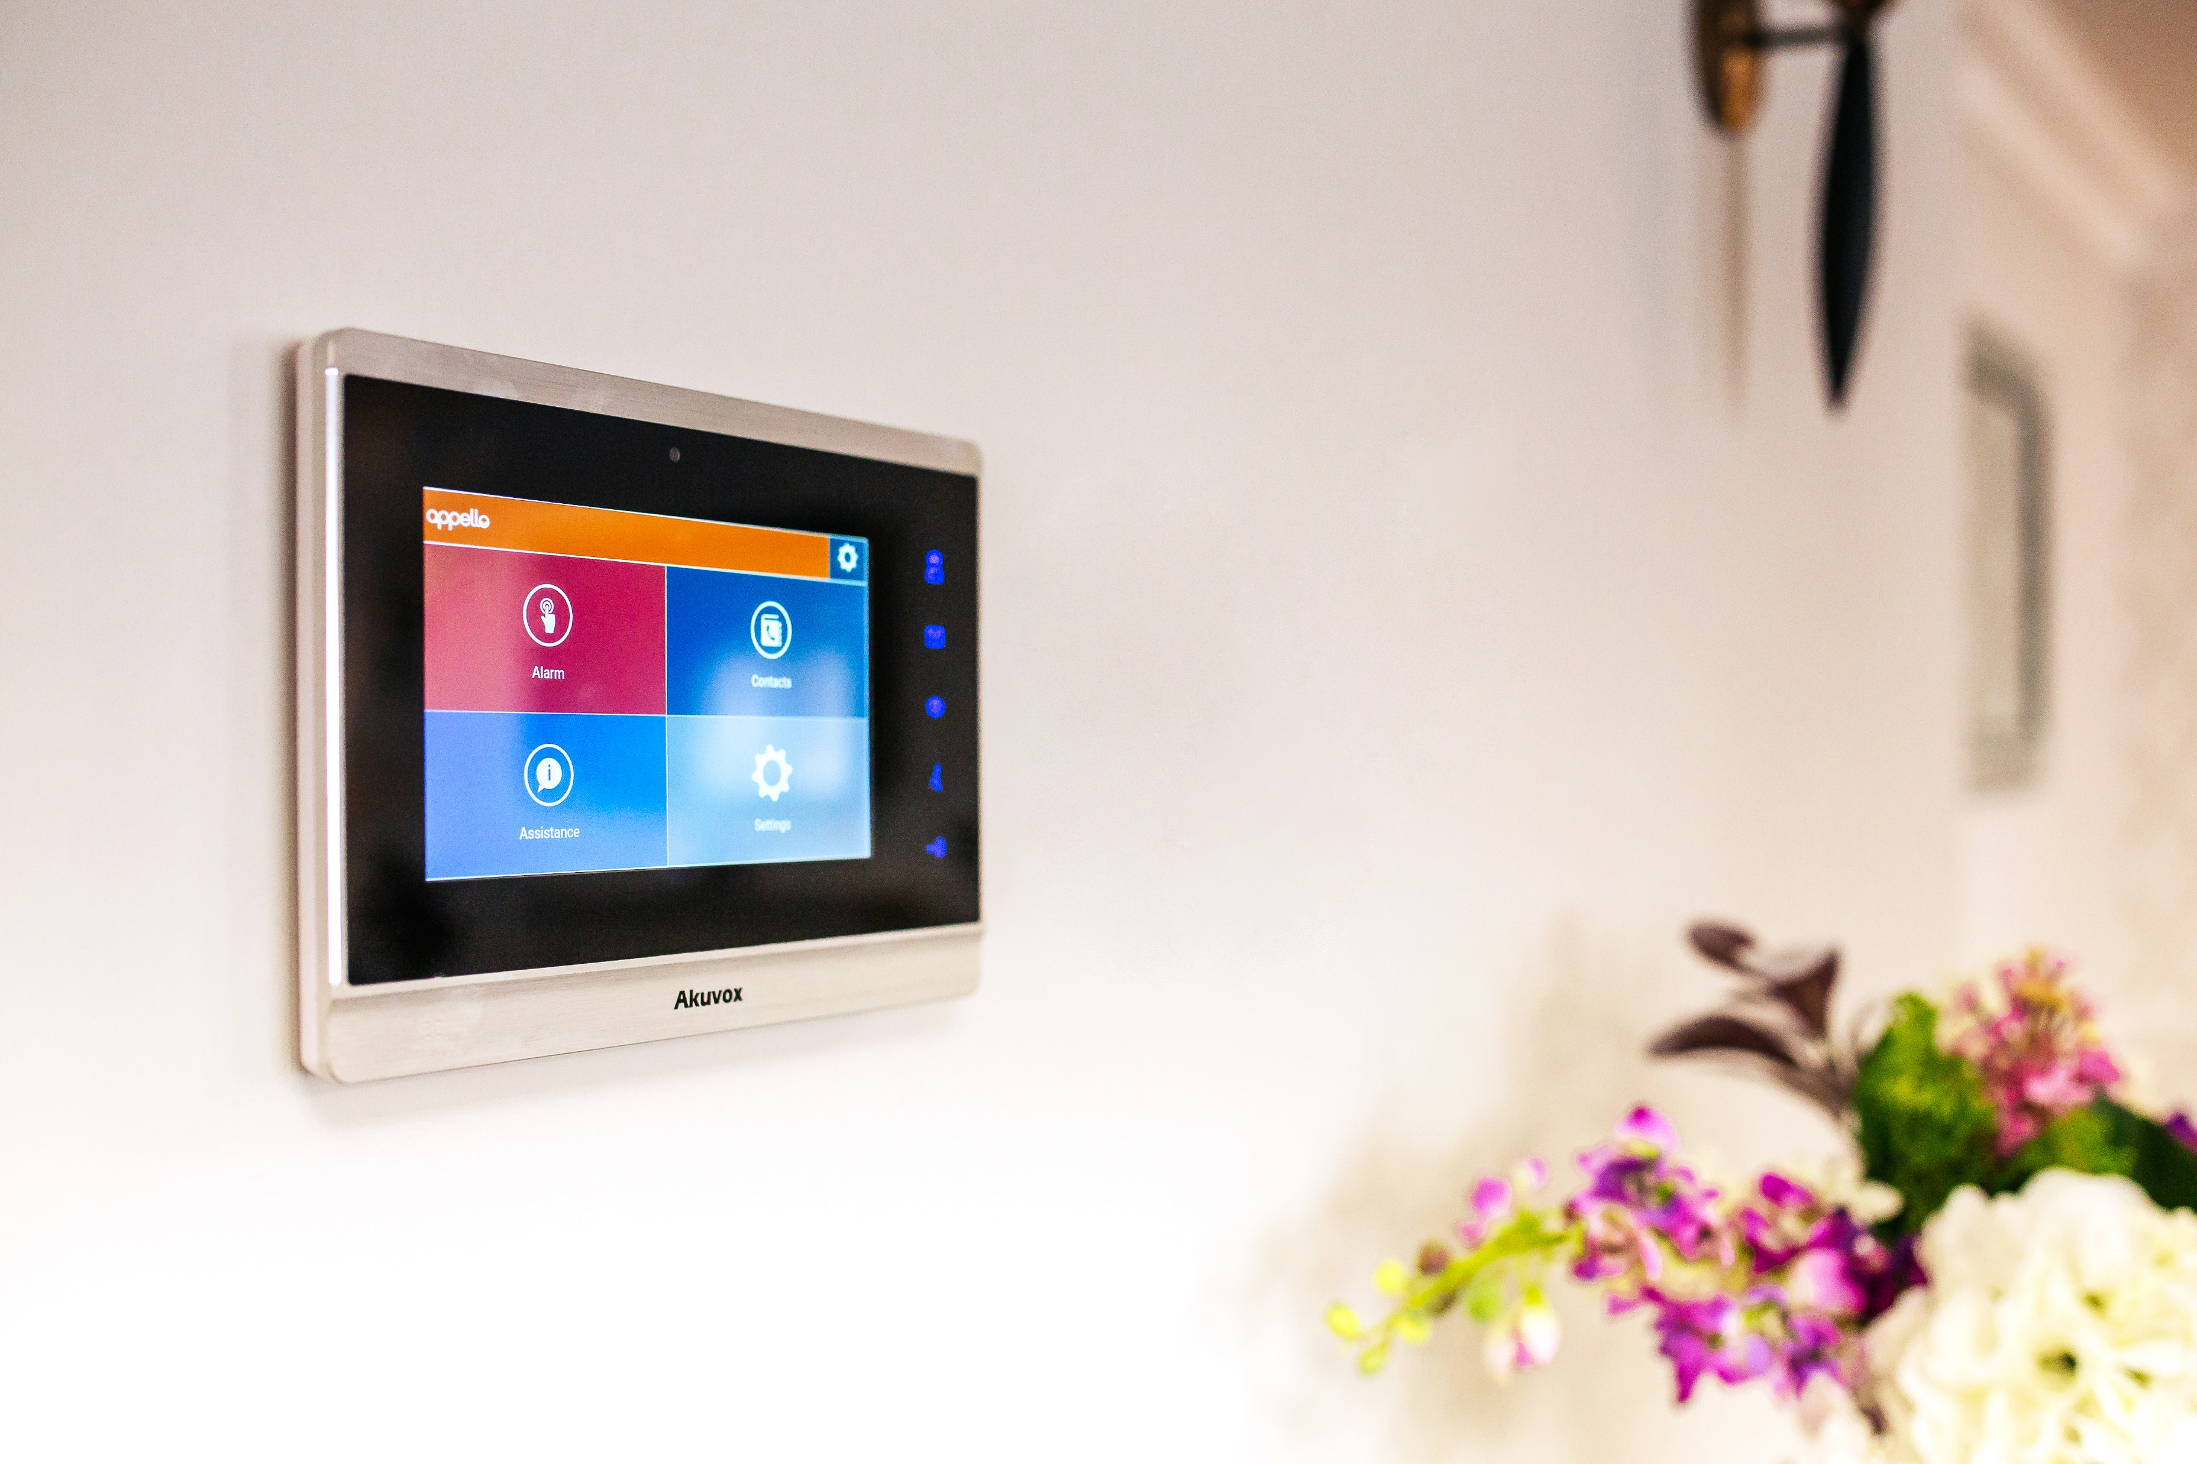

SLS and SmartConnect
Digital Network Ready
3s Connection Speed
Simultaneous Calling
I'm OK Notification
Cloud Management App

Slide 12
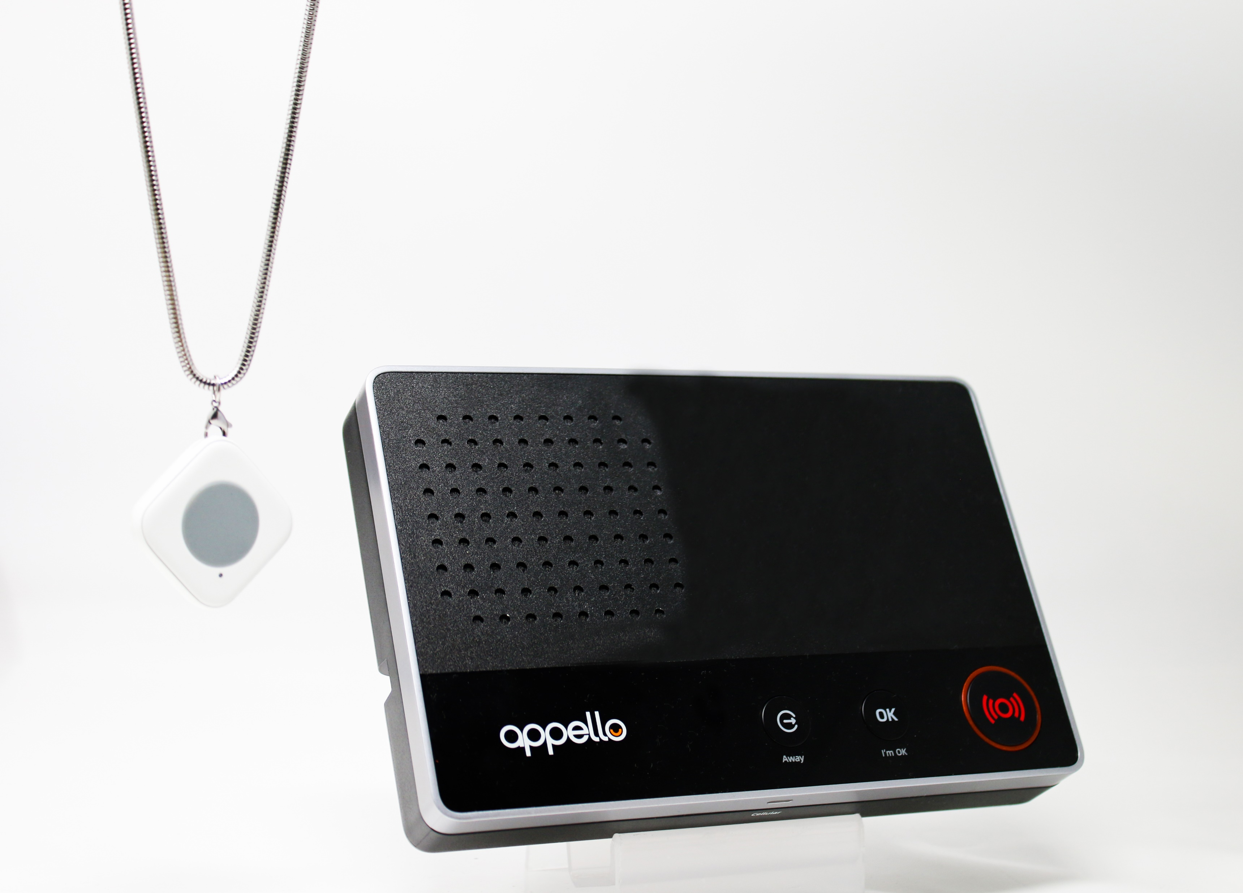


Approximate Pricing
SmartLife- Dispersed GSM Alarm with monitoring - £175 per unit
SmartLivingSolution (SLS) - Built-in High Spec multi-function system - £1,350 per unit
SmartConnect - Hard-wired call system with monitoring - £750 per unit

Slide 13
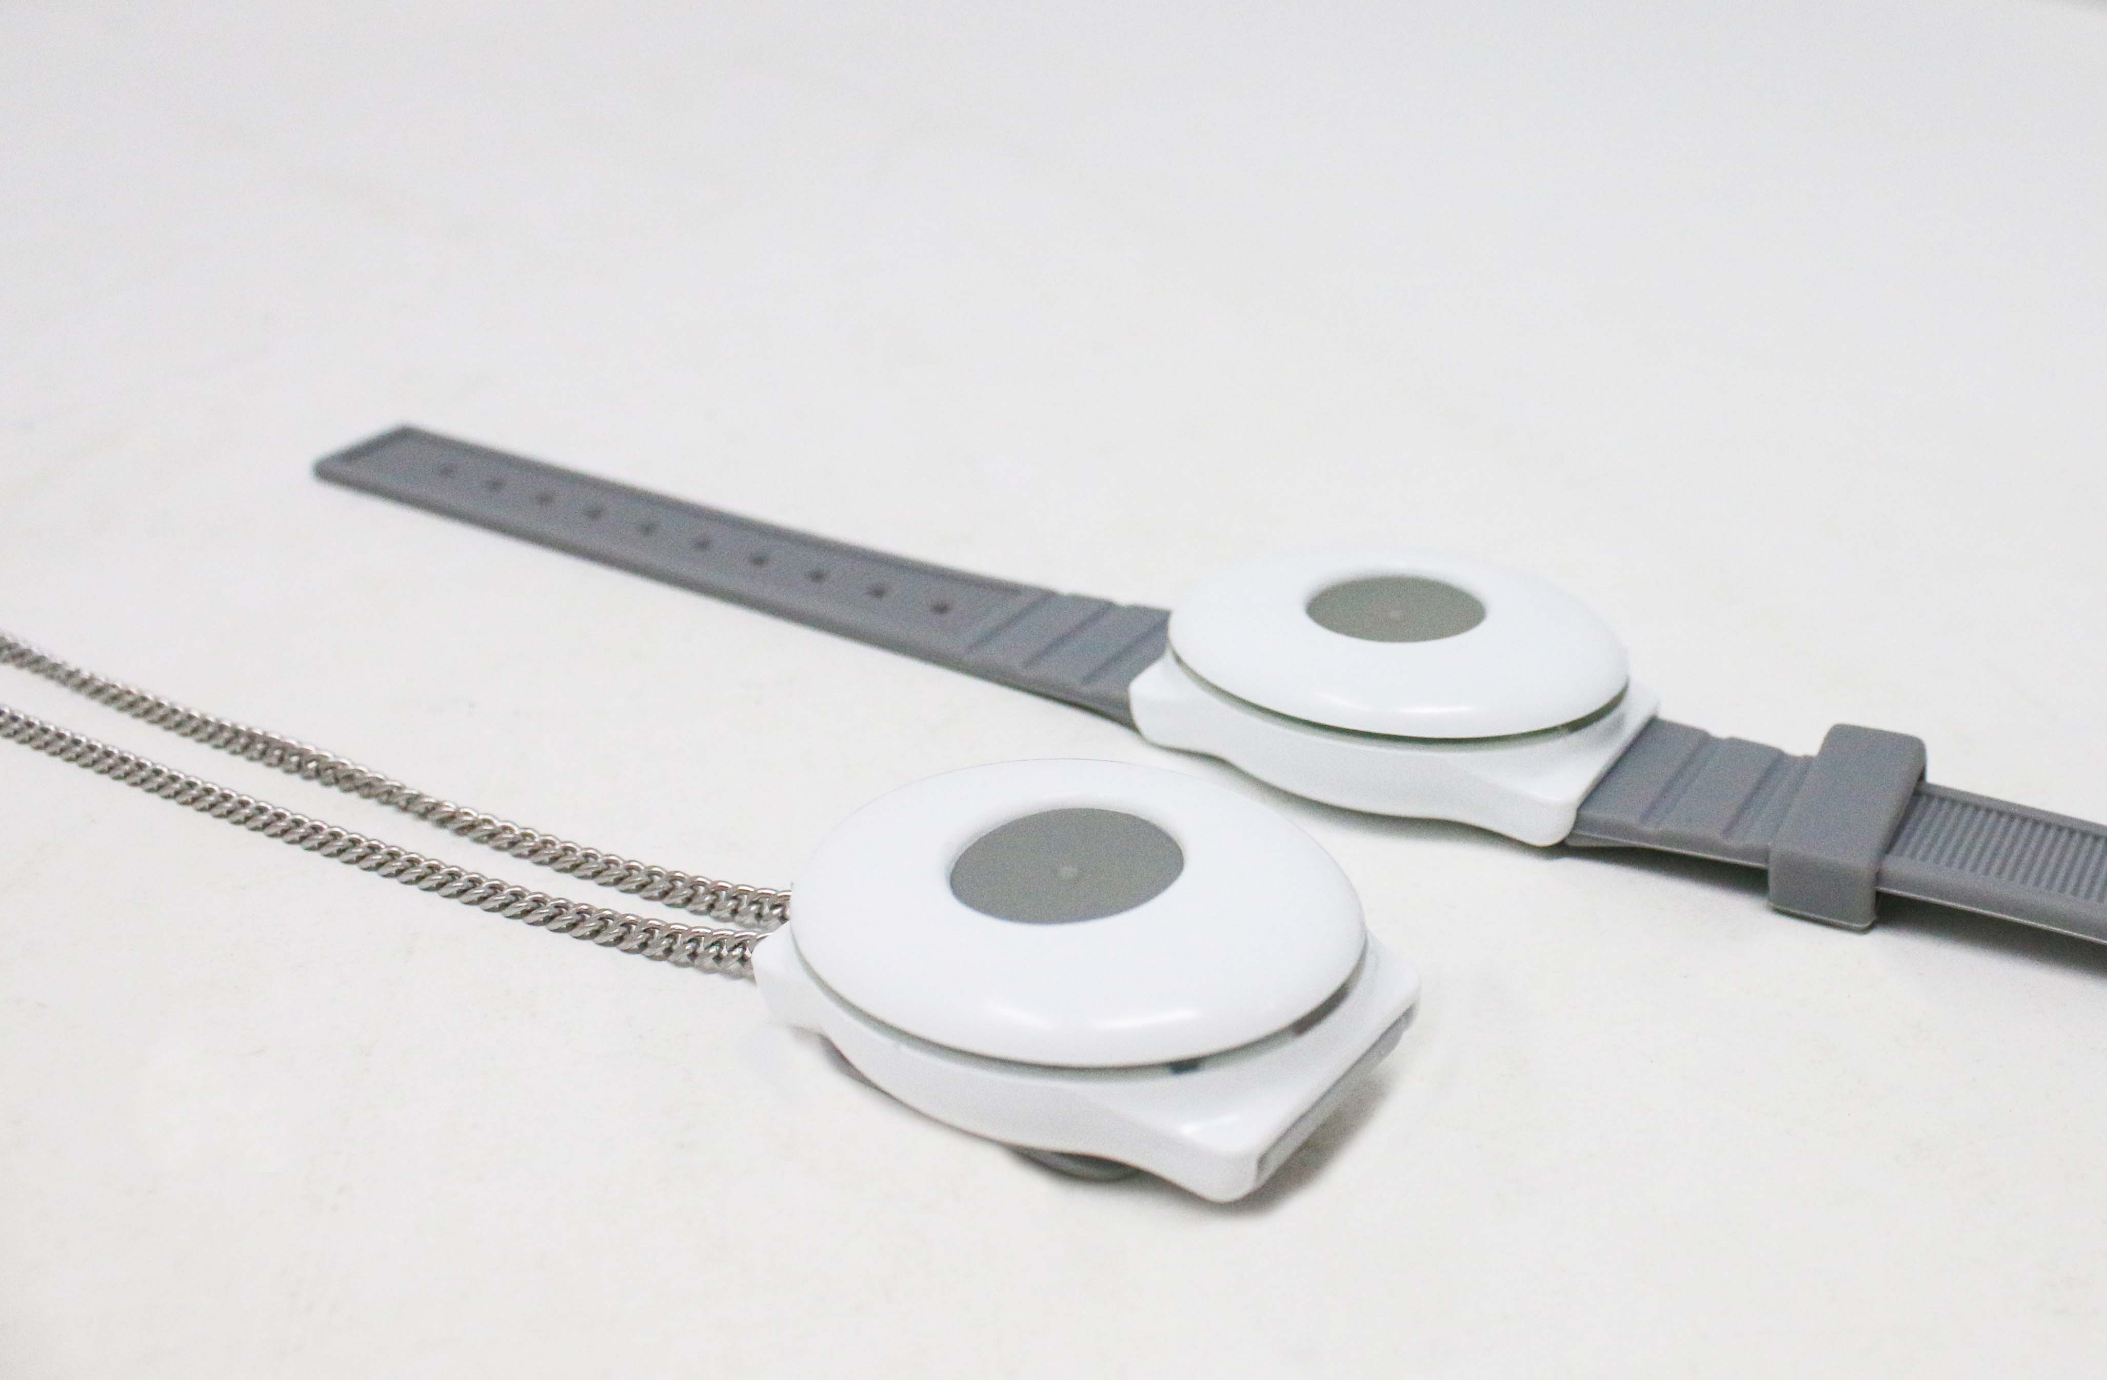
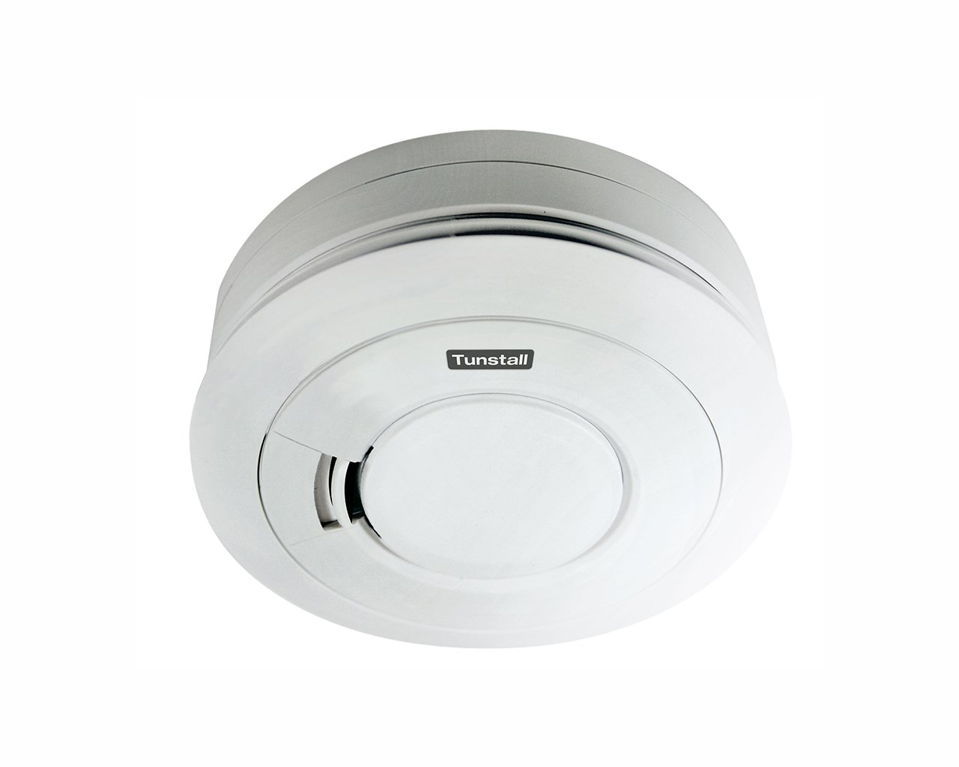
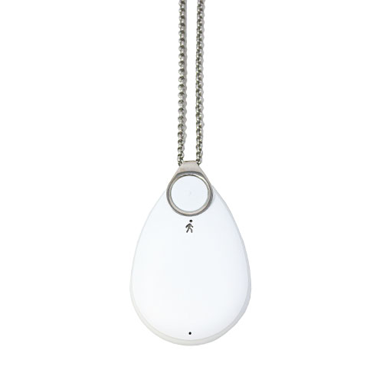
Additional Peripherals & Sensors

Slide 14
24/7 Monitoring
Full TSA (Telecare Services Association) Membership with QSF Quality Standards Framework accreditation.
ISO:9001 certified.
24/7 Alarm centre with fully trained staff ready to receive calls 365 days a year.
999 Protocol option.
Welfare calls available.
Activations/calls stat reporting.

Slide 15










Careline365
UK based monitoring and response centre
Care Team accredited by the TSA
Rated Excellent
+6,000 Customer Reviews
24/7 Care Team
25+ Partnerships
Over 60,000 customers
Carbon Neutral

Slide 16
What to do next…
Get started – the time is now.
Talk to your service providers and other suppliers if necessary.
Confirm a timeline and set out your priorities.

Slide 17
Making An Enquiry
E-mail – keyaccounts@careline.co.uk
Call us: 01603 964306 – We’re always happy to talk through your requirements and tailor a package that is suitable for your almshouse.
A dedicated accounts manager from day one.
Special discount available for your charity.

