Slide 1

Risk Assessments and Risk Assessing

Slide 2

Welcome
Integral Safety are health and safety professionals operating primarily in the housing and care sectors. We have a wealth of time-served experience in these sectors and are registered as an Almshouse Panel Consultant.
Health and safety doesn’t need to be confusing, difficult or boring. We find that positive engagement with our clients brings out the best in them and their teams.
There are two sides to good management with regards to safety in the housing, we consider the people and the properties. It can be too easy to concentrate on one over the other, but the most important thing is the balance between the two.

Slide 3

Do We NEED to Complete Risk Assessments?
YES!
Why?
Health and Safety at Work etc. Act 1974
Section 2(1) - It shall be the duty of every employer to ensure, so far as is reasonably practicable, the health, safety and welfare at work of all his employees.
Section 3(1) - …that persons not in his employment who may be affected thereby are not thereby exposed to risks to their health or safety.
The Management of Health and Safety at Work Regulations 1999
Section 3(1) Every employer shall make a suitable and sufficient assessment of
(a) the risks to the health and safety of his employees to which they are exposed whilst they are at work; and
(b) the risks to the health and safety of persons not in his employment arising out of or in connection with the conduct by him of his undertaking
Also the Occupiers Liability Act 1984 Section 3(1)
The Manual Handling Operations Regulations 1992
Section 4(1)(b)(i) - Each employer shall…. make a suitable and sufficient assessment of all such manual handling operations to be undertaken by them

Slide 4


Hazard or Risk
Understanding the Difference
www.integralsafetyltd.co.uk info@integralsafetyltd.co.uk 01530 382 150

Slide 5

What is a Hazard?
A hazard is something with the potential to cause harm.
What is a Risk?
The potential for the hazard to cause harm and how seriously.
Likelihood and Consequence

Slide 6
Discussing Hazards
Some hazards are difficult to perceive without context, some that we see a lot are:
Electricity
Asbestos
Slips, Trips and Falls
A better way to identify them could be:
Fire resulting from faulty electrical equipment
Shock resulting from contact with live cables when drilling
Health conditions arising from release of asbestos
Injuries resulting from slipping on wet moss on the ground
Injuries resulting from tripping on damaged carpets

Slide 7

5 Steps to Risk Assessment
www.integralsafetyltd.co.uk info@integralsafetyltd.co.uk 01530 382 150

Slide 8

Identify the Hazards
Look around the place, the activity and think about what has the potential to cause harm and how will it happen, consider:
What tasks are being performed?
Does the weather or other factors affect things differently?
What equipment is being used?
Who is performing the task?
Do they have health issues?
Do they need training for the task?
Could this harm anyone else not doing the task?
Does this task need doing regularly?
If property, what is the condition of the building?
If we control this hazard, might we create another?
Identify the Hazards
Assess the Risks
Control the Risks
Record Your Findings
Review the Controls
www.integralsafetyltd.co.uk
Notes:
Example, we decide that cleaning windows from a ladder is too dangerous and move to a pole reach system, we will no longer fall but we could get back pains and other issues arise.

Slide 9


Identify the Hazards
Consult with others.
A lot of the time the risk assessor doesn’t do the task or activity, they rely on others to tell them information to guide the assessment.
Identify the Hazards
Assess the Risks
Consider other sources too:
Instruction Manuals
Care Labels / Safety Data Sheets
Codes of Practice
Guidance Documents
Legislation
Control the Risks
Record Your Findings
Review the Controls
www.integralsafetyltd.co.uk

Slide 10
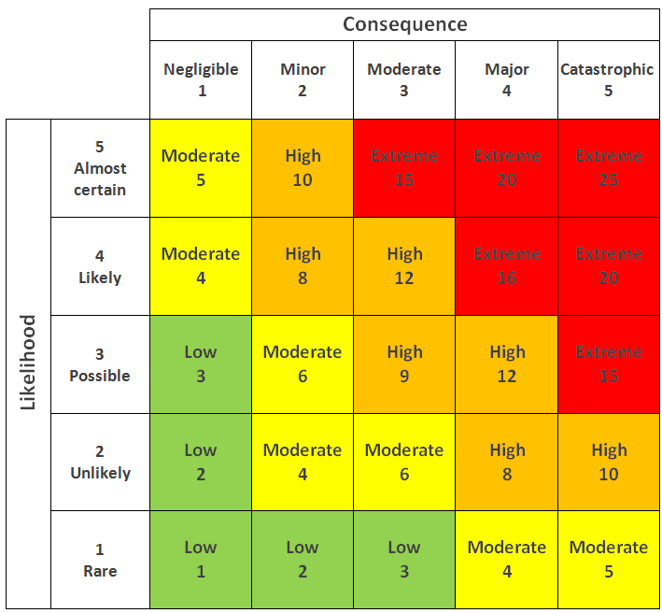
Assess the Risks
Qualitative vs Quantitative
Qualitative
A personal assessment of the risks usually demonstrated as Low, Medium or High. These offer little guidance and is left to personal opinion.
Identify the Hazards
Assess the Risks
Quantitative
A numeric assessment that allows the assessor to select against a scale of likelihood x consequence, this then generates a risk score.
This leave a lot less to interpretation and is the preferred method used by most safety professionals.
Control the Risks
Record Your Findings
Review the Controls
www.integralsafetyltd.co.uk

Slide 11
Control the Risks
Now you know the risks, what are you going to do to prevent or control them?
Identify the Hazards
Example Scenario:
In your risk assessment there is a high chance that someone will get hurt tripping over the uneven slabs around your scheme, what controls may help to prevent this?
Assess the Risks
Control the Risks
Record Your Findings
Review the Controls
Possible Solutions:
Hire a contractor to come and repair the slabs
Ensure the contractor is competent
Check the works when they are completed
Introduce a monthly slab checking programme
Ensure the checks are recorded, dated and images taken
www.integralsafetyltd.co.uk

Slide 12
Control the Risks
Consider the Hierarchy of Control
When deciding how to control risks, we use a hierarchy of control.
Identify the Hazards
Another Scenario:
Your building has a large flat roof and you decide that your team can go and sweep leaves and tree debris off of it. To stop them falling, you decide you will buy harnesses and lanyards for them, is this the best control?
Assess the Risks
Control the Risks
Record Your Findings
Collective Protection:
A piece of PPE will protect the person wearing it. You should always consider the protection of the many over the individual when planning controls.
Review the Controls
Eliminate
Reduce
Isolate
Control
PPE
D
www.integralsafetyltd.co.uk
Notes:
Eliminate: Out-source the task, consider alternate ways.
Reduce: Put a scaffold around to prevent falling, if space it limited, use fall bag or mats. COLLECTIVE PROTECTION.
Isolate: Not usually an option for this type of task (this is usually screens or guards possibly on machinery, viral protection or radiation protection).
Control: Ensure only those who are supposed to do the job are on the roof. What about controlling the area below the falling debris?
PPE: Harness and lanyards can be used, what will they be connected to? Is there a man-safe system? Is there a rescue plan (Suspension trauma)? Awareness meeting describing the risk.
Discipline: Tell people not to go near the edge, pay attention.

Slide 13

Controlling the Risks
Likelihood or Consequence?
We Normally Change the Likelihood NOT the Consequence
Consider almost any task, we look at ways to prevent the hazard from taking place.
IF the hazard were to take place, the consequence of this will usually be the same.
We only change the consequence if we change the way we do the task completely.
Identify the Hazards
Assess the Risks
Control the Risks
Record Your Findings
Review the Controls
www.integralsafetyltd.co.uk

Slide 14
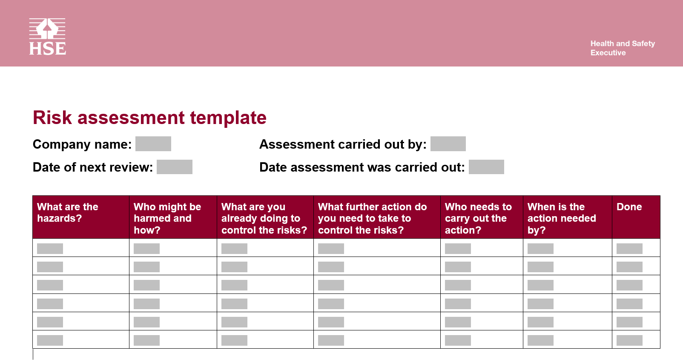
Record Your Findings
The findings are recorded on your risk assessment, you can use the HSE – Five Steps. Note, this doesn’t have a place to record the assessment of the risk, either Qualitatively or Quantitatively.
Identify the Hazards
Assess the Risks
Control the Risks
Record Your Findings
Review the Controls
We would recommend using something self created or find a template from other sources.
www.integralsafetyltd.co.uk

Slide 15
Review the Controls
All risk assessments should be dated with a review date, you need to ensure to review the document within the prescribed date to ensure it still does what it needs to do.
You should ALWAYS review the document:
At or about the review date
Following an accident or incident
After a change of method or equipment
Following any other changes likely to affect the safety of the activity
Identify the Hazards
Assess the Risks
Control the Risks
Record Your Findings
Review the Controls
www.integralsafetyltd.co.uk

Slide 16

Questions and Discussion
www.integralsafetyltd.co.uk info@integralsafetyltd.co.uk 01530 382 150

