Slide 1
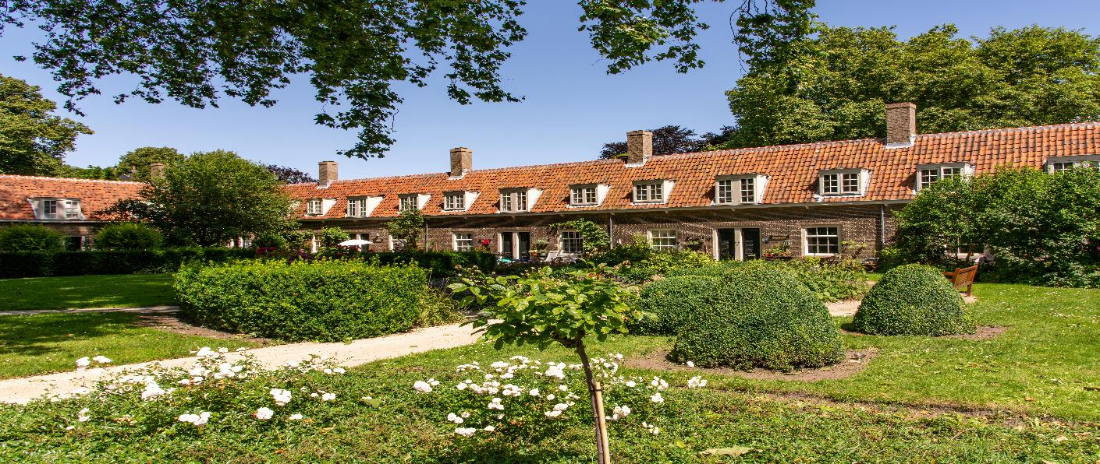

Independent living
Almshouse Association webinar
Lisa Watson-Cook, Rachel Gimson and Nicole Ridgwell, Partners | 14 May 2025

Slide 2

Preliminaries
Who we are
Charity law and governance, land law, litigation and regulated care
Law in England (slightly different in Wales)
Format of webinar
Questions?

Slide 3
Trustee concerns
How far does your duty of care to residents extend
When can you say a resident:
is no longer able to live independently
lacks capacity
What level of onsite support is acceptable
How to approach families and the authorities
What are your obligations under the Equality Act
What kind of residents’ personal data can you collect
What steps are required to set aside an appointment in these circumstances

Slide 4
Trustee concerns (2)
8. Your governing documents and policies are not compliant and don’t cover you for these scenarios
9. Are you able to set aside appointments of residents:
with increasing need for care and support not wishing to give up their almshouse
taking extended absences due to ill health
breaching the rules about visitors due to care needs
10. Experiencing challenges with relevant third parties, e.g.: Family, Social services, NHS – for example do we have to accept a resident discharged from Hospital with an ongoing condition?

Slide 5
Trustee duties
Charity governance & regulation including Safeguarding
Health and Safety/HSE
Equality Act 2010 /EHRC
Privacy and confidentiality/ICO
Mental Capacity Act 2005
Rules of ‘natural justice’
Sector custom and practice/AA
NB the more you do the weightier your duty of care

Slide 6
What is almshouse accommodation
Residents occupy as beneficiaries under a trust
May include disabled people, those with mental health problems or older people – eligibility criteria
Almshouse is their ‘home’ but occupied under licence, not tenancy
Licence conditions:
governing documents, letter of appointment and
handbook/policies

Slide 7
What almshouses are not
Almshouses do not as a rule provide meals, personal care or domestic support
Not assisting living, extra care, residential care
Housing for over-55s with low-level care and support needs may be ‘sheltered’....consider all support beyond housing: wardens, alarm systems, communal facilities?
Notes:
No statutory definition...
Provision of extra housing facilities and services
Support can be physical and/or emotional/ mental. Often includes:
24-hour emergency help (alarm system)
warden
communal facilities, e.g. lounge, laundry, garden
social activities

Slide 8
Regulation of almshouses
Almshouses are not regulated care providers – breach is a criminal offence
BUT some almshouses are, as landlords, RSH registered providers
Almshouses deemed to be providing care, support and supervision to residents may be regulated under Supported Housing (Regulatory Oversight) Act 2023 (implementation in consultation)
Housing providers have additional statutory requirements for tenancies – but almshouses should follow good practice

Slide 9
Definition of personal care in England
Physical assistance given to a person in connection with: eating or drinking, toileting, washing or bathing, dressing, oral care, or care of skin, hair, and nails OR
The prompting, together with supervision, of a person, in relation to the performance of any such activity – whether or not that person is able to make that decision for themselves
Regulated by Care Quality Commission (CQC)
Health and Social Care Act 2008 (Regulated Activities) Regulations 2014
Notes:
e.g. people not acting in their own best interests, not taking medication. Waiting outside the bathroom. Set of principles. Sometimes an act of goodwill can cross the line.
Nb wardens, neighbours. Exemption for friends etc informal/infrequent....avoid. Different in a private home. Assumed responsibility/liability. Nb insurance.
Need to be confident that staff know. Cross over with safeguarding.

Slide 10
Equality Act 2010
EA2010 prohibits discrimination - direct/indirect- against people with protected characteristics like age or disability
Failure to appoint/evicting a resident because of or as a consequence of a disability would amount to direct/indirect discrimination
Avoid breach if you can show the treatment is a proportionate means of achieving a legitimate aim
Obligation to make reasonable adjustments e.g. install grab rails etc.
Notes:
Defence to possession proceedings or argument from family/LA. Beginning middle and end of residency. Charity exemption very narrow.
Nature of adjustments – relative to context.
Trustees manage precious charitable resources; if a resident needs increased care, his/her needs may not be sufficiently met at the Almshouse

Slide 11
Privacy and data protection
UK GDPR provides a framework for making decisions about sharing personal data
Personal data must only be disclosed when it is necessary and appropriate
Be particularly careful with special category data including health; processing must have a lawful basis (Art 6) + an additional condition (Art 9)
Keep good records and be open about what you do with residents’ data
Consider restricted access and follow ICO guidance on data sharing
Notes:
JAPAN
Ensure that only certain staff /trustees have access to health data and share it only if appropriate and necessary. Sharing with LA if concerned about safeguarding.

Slide 12
Mental capacity
Assume a person has capacity to make decisions (including unwise ones) and help them make their own decisions
Decisions taken under an LPA (finance/health & welfare) must be in person’s best interests
Care provided to someone who lacks capacity should be the least restrictive of their basic rights and freedoms
If no trusted person, seek an independent advocate
Notes:
Individual is at heart of decision-making. Escalate concerns about capacity to safeguarding lead. Need policy about what to do next e.g. next of kin/ASS.
LPA – need to see. Lack of capacity does not automatically mean lack of independent living. Fluctuates/depends on complexity.
Point of knowledge, need to act.

Slide 13
Setting aside
Grounds for terminating?
Follow governing and appointment docs
Welfare/safeguarding is priority - allocate lead
AA guidance - series of clear warnings
Involve family, social services, appropriate adult as necessary
Fully reasoned ‘best interests’ decision (CC27)
NB conflicts of interest
Consider: GDPR, MCA, EA2010
Notes:
Choose an objective rather than one that is subjective or need value judgment. Technically don’t need grounds – licence.
Special meeting.

Slide 14
Setting aside (2)
Requirement of reasonableness & proportionality – consistency often raised
Liaison with resident, family and services as voluntary rehousing preferable
Protection from Eviction Act – min 4 weeks’ notice
Don’t accept maintenance contributions
Application to County Court for possession
Notes:
Get 1977 Act notice professionally drafted. Investment of time and money. Be careful using templates.

Slide 15
Independent living
Address in licence/appointment paperwork
Have a policy and follow it – use for discharge from hospital cases
Reasonable definition - for example LAs often use daily care package of up to four standard visits from a regulated care provider
Have needs assessment carried out by social services – s.9 Care Act 2014
Avoid regulated activities being provided by neighbours or staff
Notes:
Monitoring issue of keys.

Slide 16
Final words of wisdom
Review your objects, powers and licence documents to clarify eligibility and grounds for setting aside
Assess the types of support the Almshouse actually provides and how it is regulated
Adopt/review Safeguarding, Privacy and Complaints policies in addition to Independent Living Policy
Ensure everyone understand the parameters of independent living and what you as an almshouse are there to do.

Slide 17

Thank you for listening!
Lisa, Rachel and Nicole

Slide 18



Lisa Watson-Cook | Partner
Nicole Ridgwell| Partner
lisa.watson-cook@la-law.com | 023 8082 7444
nicole.ridgwell@la-law.com | 023 8082 7444
Rachel Gimson | Partner
rachel.gimson@la-law.com | 023 8082 7444

